Slide 1

TCF’s DNA 2025 Part 4 (of 4)
Our Church’s Identity,
by Andy Acreman
25th May 2025

Slide 2
What is TCF’s DNA?
The foundational principles, beliefs and practices that TCF was ‘born’ with – which God built into us from the mid 1970’s when the church was ‘born’ under Mike Godward’s leadership. 50 years ago!
Today is the fourth of four teaching sessions
Notes:
Just like DNA in a human, our spiritual DNA defines us as a local church. It’s the combination of all these characteristics that makes Thurrock Christian Fellowship unique.

Slide 3

Summary: Our DNA – 4
Key Attitudes
Welcoming and Accessible to All
Generosity as a Heart Attitude
God Receives the Glory – We gratefully give him all the credit for our success
Notes:
To Summarise…

Slide 4
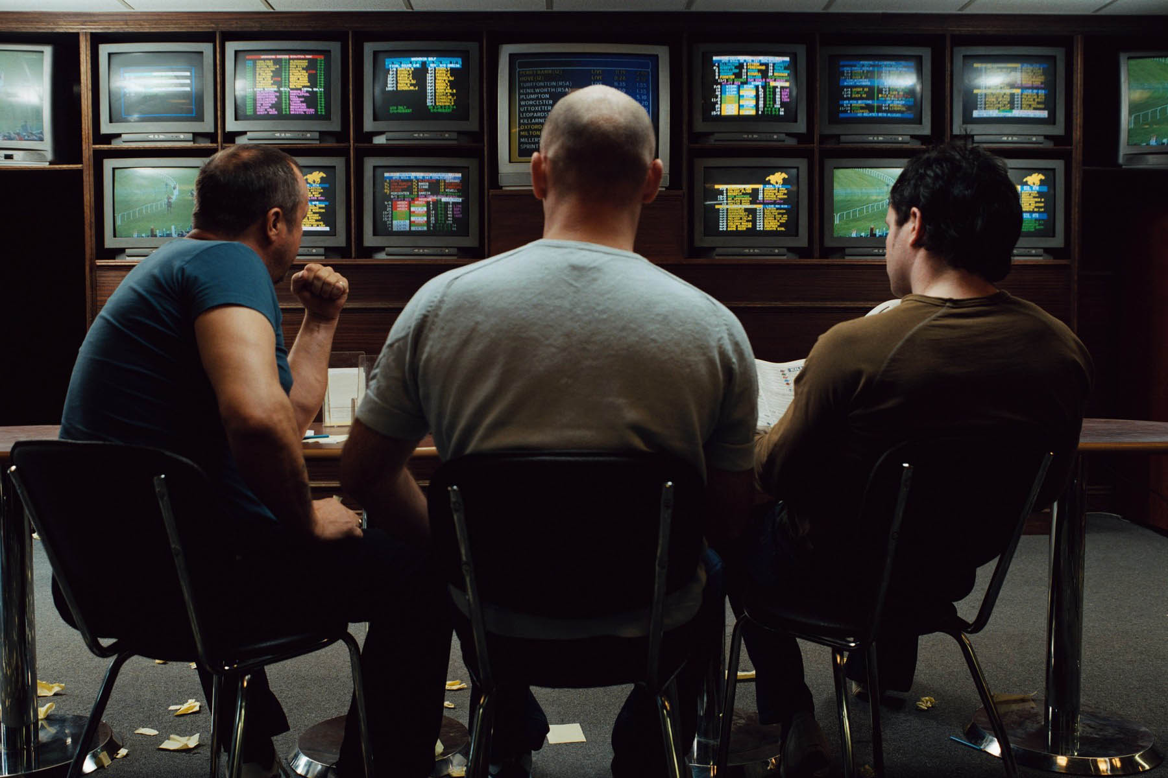
Welcoming and Accessible to All
Notes:
Who has ever walked alone into a betting shop? Why not?
What would it take to get you over the threshold into a betting shop?
This is how a member of the public feels when he/she comes into TCF for the first time!
Very much out of their comfort zone. “Like a fish out of water”.
Not sure what is expected or how to behave. No-one tells you what to do.
‘Foreign’ – they are not my kind of people
Unwelcome; not part of the ‘tribe’. “Why am I even here?”
Everyone stares as you walk in – perhaps you are interrupting something important
No-one greets you or acknowledges you

Slide 5
Welcoming and Accessible to All
Acts 28:30 NIV. For two whole years Paul stayed there in his own rented house and welcomed all who came to see him..
Romans 15:7 ESV Therefore welcome one another as Christ has welcomed you, for the glory of God.
Galatians 3:26-28 NIV. So in Christ Jesus you are all children of God through faith, for all of you who were baptized into Christ have clothed yourselves with Christ. There is neither Jew nor Gentile, neither slave nor free, nor is there male and female, for you are all one in Christ Jesus.
Notes:
Unlike every club on earth, we exist for Jesus and for every non-member! No-one is denied access, all are given a warm welcome, and no-one is treated more favourably than another. We welcome outsiders because we were once outsiders and Christ welcomed us. TCF has always been friendly and welcoming – it’s in our DNA!
When outsiders visit us, we should be warm, kindly, friendly, hospitable, informative, even sacrificial. They will already be feeling rather uncomfortable, so we must make ourselves even more uncomfortable to make them feel at home. We all feel a bit shy or tongue-tied (except for Judith) when strangers come in – but we need to love them by pushing through this fear.
It should not be the role of the leaders or one or two others to receive newcomers; HERE (everyone) is the Welcoming Team! Let’s all learn to receive guests well.
We need to be ready to accept them on their terms too, without being judgmental or censorious. They might be noisy, smelly, sweary or opinionated. They might have badly-behaved children. They might even have short attention-spans!
So we need to be flexible and not too ‘precious’ about the way we normally do things. We will probably need to explain things – things that are so obvious to us. As a church we will need to become more ‘user-friendly’.
Of course, we are not just thinking about newcomers visiting our meetings. Many others don’t yet realise that they NEED to belong to us, so we must go ‘out there’ to find them! TCF is not just upward-looking and inward-looking, but also outward-looking! Declaring and demonstrating the Kingdom of Heaven on Earth. Having confidence in the gospel of Christ.
And in our meetings, let’s make a habit of giving a gospel invitation and offering prayer for the sick.

Slide 6
Welcoming and Accessible to All
James 2:1-4 NIV.
My brothers and sisters, believers in our glorious Lord Jesus Christ must not show favouritism. Suppose a man comes into your meeting wearing a gold ring and fine clothes, and a poor man in filthy old clothes also comes in. If you show special attention to the man wearing fine clothes and say, "Here's a good seat for you," but say to the poor man, "You stand there" or "Sit on the floor by my feet," have you not discriminated among yourselves and become judges with evil thoughts?
Notes:
Did you know that the Church is the pioneer of ‘equality’ – and it’s quite weird that certain worldly groups think they invented it.
Let’s consider whether we have any hidden prejudices or discriminations. Do we act or react differently towards different people just because we like some more than others? Is that loving or Christlike? Do we make an effort to treat people fairly?
It doesn’t mean that we are all the same – identical or equally good a everything; no! But, as humans, we are created in the image of God and as Christians we are brothers and sisters of Christ. We are all ‘family’.

Slide 7
Welcoming and Accessible to All
1 Corinthians 14:24-25 NIV.
But if an unbeliever or an inquirer comes in while everyone is prophesying, they are convicted of sin and are brought under judgment by all, as the secrets of their hearts are laid bare. So they will fall down and worship God, exclaiming, “God is really among you!”
Gatherings are primarily for believers
Unbelievers are convinced by authenticity
Notes:
Church gatherings are primarily for us, the people of God, to meet together, to build one another up in their faith. But from time to time, unbelievers or seekers might walk in through the door.
Being welcoming is not an excuse for dumbing down our worship, teaching and supernatural gifts, in an effort to find some common denominator. We must be authentic and obey the word of God and the Holy Spirit.
As we can see from the above verses...
So: ‘Welcoming and Accessible to All: It’s in our DNA!”

Slide 8
Generosity as a Heart Attitude
Proverbs 11:24-25 NIV. One person gives freely, yet gains even more; another withholds unduly, but comes to poverty. A generous person will prosper; whoever refreshes others will be refreshed.
2 Corinthians 8:9 NLT. You know the generous grace of our Lord Jesus Christ. Though he was rich, yet for your sakes he became poor, so that by his poverty he could make you rich.
James 1:5 NIV. If any of you lacks wisdom, you should ask God, who gives generously to all without finding fault, and it will be given to you.
Notes:
Have a read of these verses…
Like a stick of seaside rock with ‘Bognor Regis’ written through its core, TCF has always ‘Generosity’ at its heart.
Generosity is such a biblical principle. We are generous because He has already been generous to us! We forgive because He has forgiven us. Forgiveness of others releases the chains the bind us.
Generosity is a heart-principle about giving everything that you are: to the Lord, to his church, to one another. As we are generous, He is generous to us.
We are a Royal Priesthood, we are not impoverished orphans, but wealthy princes. So let’s act like the Royal Family. Our Heavenly Dad is loaded! We can afford to be generous!
It’s not all about financial giving, but it does include generous financial giving.
We should give…
Anonymously
Voluntarily
Cheerfully
Expectantly
Regularly
Spontaneously
Proportionally - to your income
Generously
Sacrificially (sometimes)
Gratefully
Let’s also practise hospitality to one another, sharing our lives and our homes as well as our money. Inviting people to our own home sometimes puts us out of our comfort zone, but give it a go!
Let’s all be a blessing to the other churches in Thurrock, rather than competing with them. Let’s put the most generous interpretation on other people’s actions and behaviours, rather than assuming the worst!

Slide 9
Generosity as a Heart Attitude
2 Corinthians 9:6-11 NIV. Remember this: Whoever sows sparingly will also reap sparingly, and whoever sows generously will also reap generously. Each of you should give what you have decided in your heart to give, not reluctantly or under compulsion, for God loves a cheerful giver. And God is able to bless you abundantly, so that in all things at all times, having all that you need, you will abound in every good work. You will be enriched in every way so that you can be generous on every occasion, and through us your generosity will result in thanksgiving to God.
Notes:
Here are some words of wisdom from Heaven…
Generosity: it’s in our DNA!

Slide 10
God Receives the Glory
Johann Sebastian Bach often wrote the initials SDG at the end of his musical compositions. (Latin): Sola Deo Gloria = ‘To God alone be the glory’.
Rev 14:7. Fear God and give him glory.
John 8:54. If I glorify myself, my glory means nothing. My Father, whom you claim as your God, is the one who glorifies me.
1 Peter 4:11. …so that in all things God may be praised through Jesus Christ. To him be the glory and the power for ever and ever
Notes:
J. S. Bach – possibly the greatest music composer ever – recognised that his greatness came from God, and so he gave the credit back to God.
Who do we give the credit to for our successes? Do we give God all the glory? Do we have an attitude of gratitude?
It is very tempting to take the credit for ourselves – either as individuals or as a church. Very few people praise us, so we feel that we need to praise ourselves a bit more: ‘Look at me, aren’t I doing well!’. But that detracts from God, and it doesn’t end well.
We can ‘practise’ by giving praise and encouragement to one another. In fact, if we did this a bit more, then we wouldn’t feel so much need to ‘big’ ourselves up.
The main reason we have ‘Good Stories’ in our meetings is to give God the glory and to show how he has blessed our lives.

Slide 11
God Receives the Glory
We live a life of gratitude towards Jesus, giving him all the credit for our successes, whilst taking full responsibility for our failures
Matthew 6. Be careful not to practice your righteousness in front of others to be seen by them. If you do, you will have no reward from your Father in heaven. So when you give to the needy… do it in secret… Then your Father, who sees what is done in secret, will reward you. …When you pray, go into your room, close the door and pray to your Father, who is unseen. Then your Father, who sees what is done in secret, will reward you.
Notes:
This is TCF’s aim – as part of our DNA…
Sadly, too many individuals, organisations, Christian groups and even churches seem to indulge in self-glorification these days, particularly on social media. It completely turns me off! It detracts from the glory that rightly goes to Father, Son and Holy Spirit.
Remember what Jesus said on the Sermon on the Mount about those who proclaim their superior spirituality publicly: they already have their reward. We should take the opposite approach – do righteous things in secret, so that our Heavenly Father will see and reward us. Why not have an agreement with the Lord that you want your reward to be in Heaven and not on earth.
One day soon, when TCF is much larger, there will be the temptations of publicity, TV, the press etc to ‘blow our own trumpet’. That will be the test of our character as a church! When we have seen some extraordinary miracles in our towns – how do we plan to respond to questions?
One day we plan to have a bigger social media ‘footprint’, to show people what services we offer to local people. But we must take great care not to deflect the glory from God, where it rightly belongs. If you think that we have failed at any time, please tell one of the leaders.
Actually, we get included in His glory if we stick close to Him anyway.

Slide 12
Summary: Our DNA – 4
Key Attitudes
Welcoming and Accessible to All
Generosity as a Heart Attitude
God Receives the Glory – We gratefully give him all the credit for our success
Notes:
To Summarise today’s Key Attitudes…

Slide 13
Challenges: Our DNA – 4
Key attitudes
What can I do to make myself more welcoming to outsiders?
How generous am I? Where is there a need for improvement?
Do I put the most generous interpretation on people’s actions and behaviours – rather than thinking the worst?
How can I better give God the glory in my own life?

Slide 14
Our DNA – 1
Gathering Together
The Presence of God in our gatherings and in our lives
The Worship of God
Supernatural Living - Relying on answered prayer and the miraculous power of God in our lives together
Notes:
To end, here are the 12 ‘strands’ of DNA that help to define us. I have arranged them in their logical sequence.

Slide 15
Our DNA – 2
Revelation
Hearing the Voice of God through his Spirit in us
The Bible is True and Inspired - To guide and teach us what living with Jesus is all about
Body Ministry - Each one of us expressing the gifts of the Spirit for the good of God’s people

Slide 16
Our DNA – 3
Corporate Identity
The Kingdom of God - Bringing the values, vision and power of Heaven to Thurrock
The Bride of Christ, the Body of Christ, and the Family of God – We are part of these heavenly identities in our local area
Leadership is 'Team’

Slide 17
Our DNA – 4
Key Attitudes
Welcoming and Accessible to All
Generosity as a Heart Attitude
God Receives the Glory – We gratefully give him all the credit for our success

Slide 18
TCF’s DNA – END of Part 4
Let’s discuss these ideas in our Community Groups next time they meet up.
Notes:
The things are part of TCF’s DNA. They define who we are in God.

